Slide 1
Grundlagen Englisch
Past perfect simple
Past perfect continuous
HFW Bern
Philipp Brunner

Slide 2
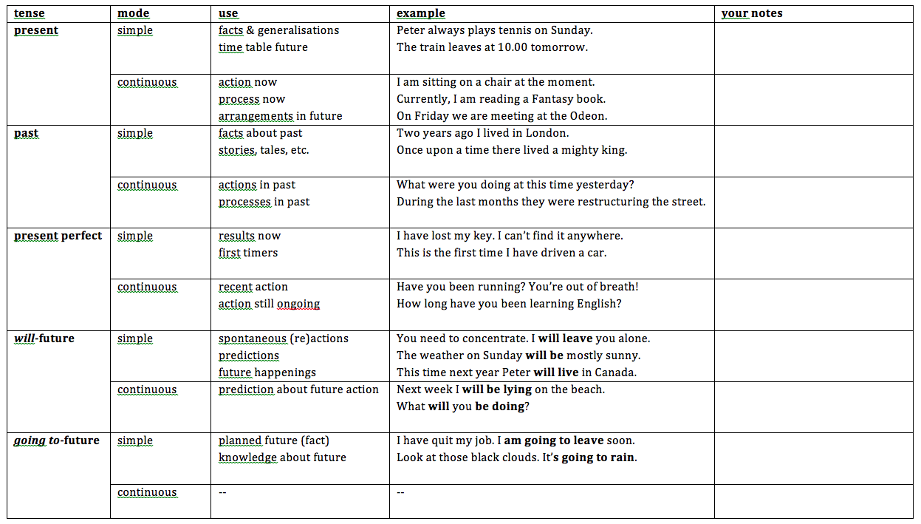
Overview – all tenses

Slide 3
Past perfect simple: forms
affirmative | negative
I He She ‘d seen the film before. It We They contractions: I`d = I had | I He She hadn`t seen the film before. It We They contractions: I‘d = I had
She had seen: had=past; seen=participle (perfect)

Slide 4
Past perfect simple: forms
questions | positive (short) | negative (short)
I you he Had she seen it before? we they | I you he Yes, she had. we they | I you he No, she hadn`t. we they

Slide 5
Past perfect simple: use
Use the past perfect when you are already talking about the past, and want to talk about an earlier past action.
→ When I woke up the garden was all white. It had snowed that night. (before I woke up)
→ I arrived at the coffee bar twenty minutes late. My friends had already gone. (before I arrived)
Make the past perfect with had / hadn’t + the past participle.
The past perfect is the same for all persons.
!!! Be careful: I’d can be I had. It can also be I would. !!!

Slide 6
Past perfect simple: use
In pairs, discuss these examples:
1a | A: Was Tom here when you arrived? B: Yes, but he left soon afterwards.
1b | A: Was Tom here when you arrived? B: No, he had already left.
2a | Kate wasn‘t at home when I phoned. She was at her mother‘s house.
2b | Kate had just got home when I phoned. She had been at her mother‘s house.

Slide 7
Past perfect simple: use
Now, discuss these examples, too:
1a | Who is that woman? I‘ve seen her before, but I can‘t remember where.
1b | I wasn‘t sure who she was. I‘d seen her before, but I couldn‘t remember where.
2a | The house is dirty. They haven‘t cleaned it for weeks.
2b | The house was dirty. They hadn‘t cleaned it for weeks.

Slide 8
Past perfect continuous: forms
affirmative | negative
I He She ‘d been working. It We They contractions: I`d = I had | I He She hadn`t been working. It We They contractions: I‘d = I had
She had been working: had=past; been=perfect; working=continuous

Slide 9
Past perfect continuous: forms (2)
questions | positive (short) | negative (short)
I you he Had she been working? we they | I you he Yes, she had. we they | I you he No, she hadn`t. we they

Slide 10
Past perfect continuous: use
Use the past perfect continuous when you are already talking about an action in the past, and want to talk about an earlier past action.
→ We’d been playing tennis for about an hour when it started to rain heavily.
→ Paul went to the doctor last Friday. He hadn’t been feeling well for some time.
Make the past perfect continuous with had / hadn’t + been + verb-ing.
The past perfect continuous is the same for all persons.

Slide 11
Past perfect continuous: use
In pairs, discuss these examples:
1a | I hope the bus comes soon. I‘ve been waiting for 20 minutes.
1b | At last the bus came. I‘d been waiting for 20 minutes.
2a | James is out of breath. He has been running.
2b | James was out of breath. He had been running.

Slide 12
Past perfect continuous: use
Now, discuss these examples, too:
1 | It wasn‘t raining when we went out. The sun was shining. But it had been raining before.
2 | Katherie was sitting in an armchair, resting. She was tired because she‘d been working very hard.

Slide 13
Your turn!
Murphy Copies: Units 15-16
Grammar Book: Unit 10
15 minutes

