Slide 1
Grundlagen Englisch
Passive voice
HFW Bern

Slide 2
Passive voice – is done, was done, etc.
When we use an active verb, we say what the subject does:
They clean this room every day.
People don’t use this road much.
When we use a passive verb, we say what happens to the subject:
This room is cleaned every day (by them).
This road is not used much (by people).
structure: subject + to be + past participle

Slide 3
Passive voice (2) – is done, was done, etc.
When we use the passive voice, who or what causes the action is unknown or unimportant:
A lot of money was stolen in the robbery.
Is this room cleaned every day?
If we want to say who does or what causes the action, we can use by:
This house was built by my grandfather.
Two hundred people are employed by the company.
structure: subject + to be + past participle + by + object

Slide 4
Passive voice (3) – is done, was done, etc.
These two sentences are present simple passive:
This room is cleaned every day (by them).
This road is not used much (by people).
These two sentences are past simple passive:
This room was cleaned every day (by them).
This road was not used much (by people).
structure: subject + to be + past participle

Slide 5
Passive voice (4) – is done, was done, etc.
These two sentences are present perfect simple passive:
This room has been cleaned (by them).
This road has not been used much (by people).
These two sentences are past perfect simple passive:
This room had been cleaned (by them).
This road had not been used much (by people).
structure: subject + have/has; had + past participle

Slide 6
Passive voice (5) – is done, was done, etc.
These two sentences are will-future simple passive:
This room will be cleaned (by them).
This road will not be used much (by people).
These two sentences are going to future simple passive:
This room is going to be cleaned (by them).
This road is not going to be used much (by people).
structure: subject + will be/going to + past participle

Slide 7
Passive voice (5) – is being done, was being done, etc.
These two sentences are present continuous passive:
This room is being cleaned (by them).
This road is not being used much (by people).
These two sentences are past continuous passive:
This room was being cleaned (by them).
This road were not being used much (by people).
structure: subject + to be + being + past participle

Slide 8
Passive voice (6) – is being done, was being done, etc.
These two sentences are present perfect continuous passive:
This room has been being cleaned (by them).
This road has not been being used much (by people).
These two sentences are past perfect continuous passive:
This room had been being cleaned (by them).
This road had not been being used much (by people).
structure: subject + have/has; had+ being + past participle

Slide 9
Passive voice (7) – is being done, was being done, etc.
These two sentences are will-future continuous passive:
This room will be being cleaned (by them).
This road will not be being used much (by people).
*These two sentences are going to-future continuous passive:
*This room is going to be being cleaned (by them).
*This road is not going to be being used much (by people).
structure: subject + will be/going to + being + past participle

Slide 10
Passive voice (8) – simple and continuous
passive simple:
structure: subject + aux. verb + past participle
passive continuous:
structure: subject + aux. verb + being + past participle

Slide 11
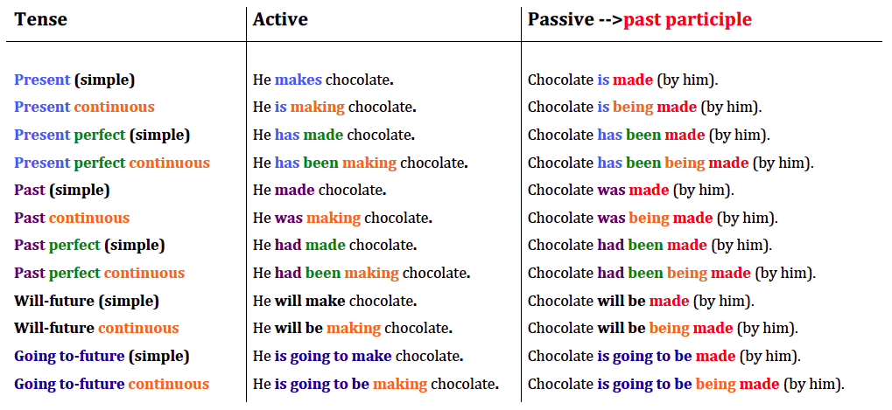
Passive voice (9) – active vs. passive

Slide 12
Passive voice (10) – active vs. passive
Transform the following sentence into passive, then into all tenses (passive!).
She hears the man. → present simple passive: ..................................................
present continuous:
past simple:
past continuous:
present perfect simple:
present perfect continuous:
past perfect simple:
past perfect continuous:
will-future simple:
will-future continuous:
going to-future simple:
going to-future continuous:

Slide 13
Passive voice (11) – active vs. passive
Transform the following sentence into passive, then into all tenses (passive!).
She hears the man. → present simple passive: The man is heard (by her).
present continuous: The man is being heard (by her).
past simple: The man was heard (by her).
past continuous: The man was being heard (by her).
present perfect simple: The man has been heard (by her).
present perfect continuous: The man has been being heard (by her).
past perfect simple: The man had been heard (by her).
past perfect continuous: The man had been being heard (by her).
will-future simple: The man will be heard (by her).
will-future continuous: The man will be being heard (by her).
going to-future simple: The man is going to be heard (by her).
going to-future continuous: The man is going to be being heard (by her).

Slide 14
your turn!!
Work on
Grammar Book: Units 21 - 22
Blue Murphy (copies): Unit 42 – 46
Vocabulary: anything you haven‘t done yet.

Slide 15
Summary
present simple & continuous active &passive
past simple & continuous active &passive
nouns & articles
adjectives & adverbs
comparison of adjectives
modal verbs
present perfect simple & continuous active &passive
present perfect simple vs. past simple active &passive
present tenses with future meaning
going to-future active &passive
will-future active &passive
Past perfect simple & continuous active &passive
Relative clauses → relative pronouns; extra information clauses

